Slide 1


AIL 411-DEEP LEARNING LAB
PREPARED BY: Asha Rose Thomas
AP,CSE(AI),ASIET,Kalady

Slide 2
EXPERIMENT 10
Implement a shallow auto encoder and decoder network for machine translation (by using Kaggle English to Hindi neural translation dataset).

Slide 3
Machine Translation (MT)
Definition:
Using AI to automatically translate text or speech between languages.
Utilizes NLP and deep learning techniques.
Challenges:
Complexity of Languages: Syntax, grammar, idioms, cultural nuances.
Context and Ambiguity: Multiple meanings of words based on context.
Idiomatic Expressions: Non-literal phrases (e.g., “kick the bucket”).
Common Neural Network Methods:
Recurrent Neural Networks (RNNs):
Early models used LSTMs and GRUs.
Struggled with long-term dependencies.
Transformers:
Most successful and widely used..
Backbone of models like BERT and GPT.

Slide 4
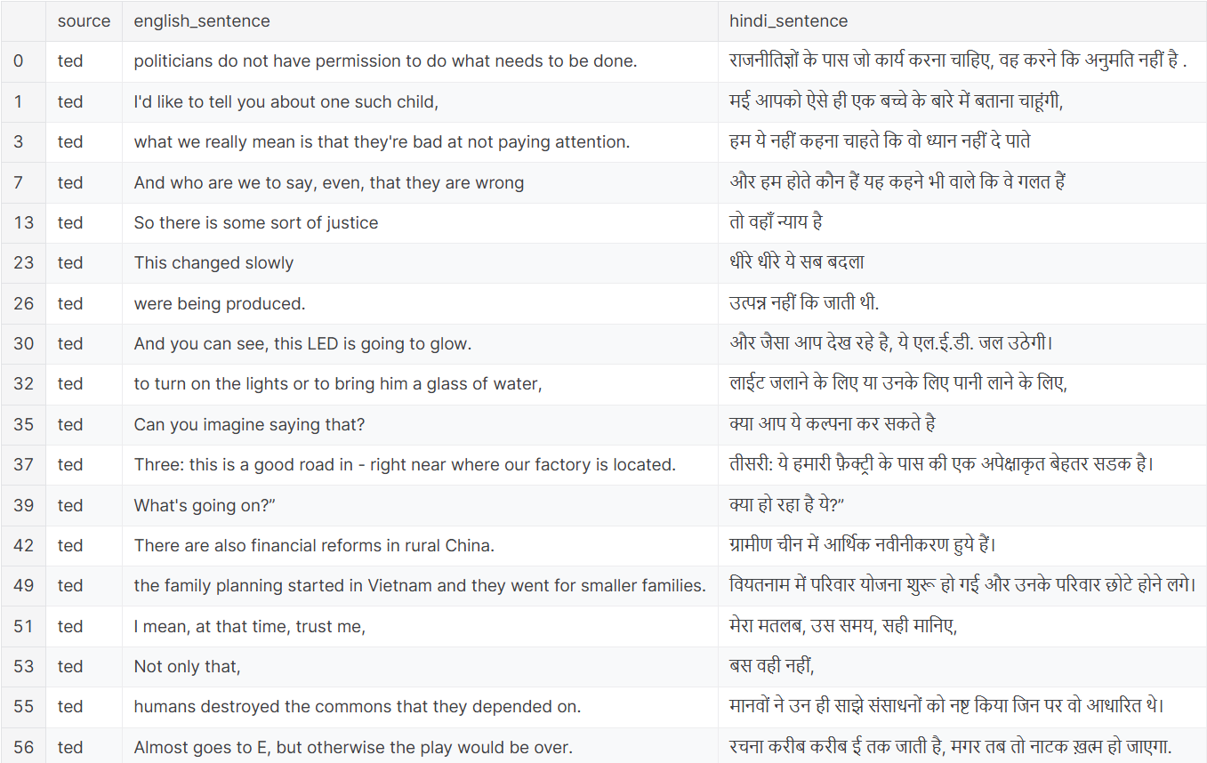
English to Hindi Translation Data set

Slide 5
Reference
HindiEnglish Corpora (kaggle.com)

Slide 6
About the dataset
The HindiEnglish Corpora dataset is a parallel corpus that includes aligned sentences in both Hindi and English. It is designed to support various natural language processing tasks, such as machine translation and bilingual text analysis. The dataset contains a substantial number of sentence pairs, making it a valuable resource for training and evaluating models. It is widely used in academic research and practical applications to improve the accuracy and efficiency of language models.

